Slide 1
CNNs for Turbulent Flow Analysis
Javad Mortazavian Najafabadi
Christopher J. Abel
April 22, 2025

Slide 2
Outline
Problem Statement
Other Reported Work
Data Source, Problem Geometry

Slide 3
Problem Statement
Why is the solution of NS equations difficult?
Hope to find efficient CNNs for both time projection and resolution projection to reduce number of NS solution points required (bad wording…)
Investigating both
Use of transformer networks to project U(t) and P(t) in time
Use of CNN encoder / decoder networks for super resolution of U(t) and P(t)
Combine U(t) and P(t) to improve both time projection and super resolution

Slide 4
Other Reported Work

Slide 5
Data Source
Briefly discuss JHTDB datasets …

Slide 6



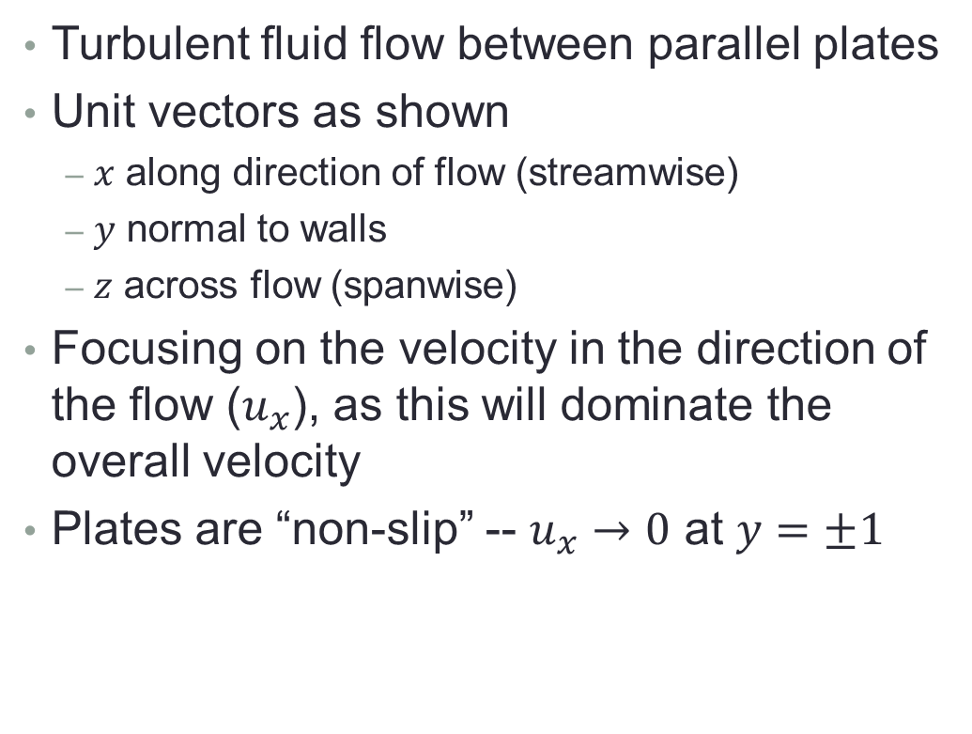




Geometry
$$\vec{y}$$
$$\vec{x}$$
$$\vec{z}$$
Side View
1
Turbulent fluid flow between parallel plates
Unit vectors as shown
$x$ along direction of flow (streamwise)
$y$ normal to walls
$z$ across flow (spanwise)
Focusing on the velocity in the direction of the flow ($u_{x}$), as this will dominate the overall velocity
Plates are “non-slip” -- $u_{x}→0$ at $y=±1$
$$\vec{y}$$
$$\vec{x}$$
Flow
-1
Front View
1
$$\vec{z}$$
$$\vec{y}$$
Flow
-1
J. Kim, P. Moin and R. D. Moser. Turbulence statistics in fully developed
channel ow at low Reynolds number. J. Fluid Mech., 177:133-166, 1987.

